Slide 1
Are my unit tests testing well? Introduction to 'behavior coverage'

Slide 2

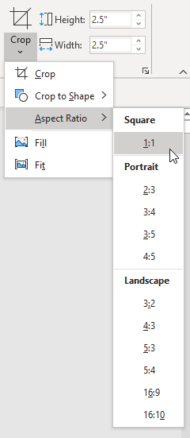
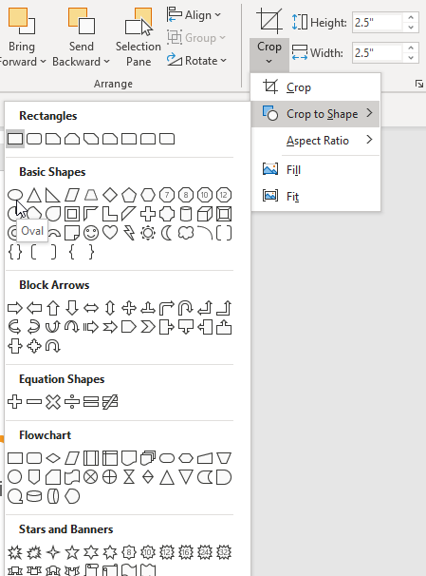
Welcome and Introduction
After inserting the photo onto the slide, click the Format tab at the top.
Click the Crop drop-down > Aspect Ratio > 1:1 to make it a perfect square.
Then go back to the Crop drop-down > Crop to Shape > and pick the Oval shape.
Place speaker’s photo over this area.
See notes on the right on how to crop your photo into a perfect circle.
1.
2.
Konrad Gałczyński
Senior Software Engineer

Slide 3

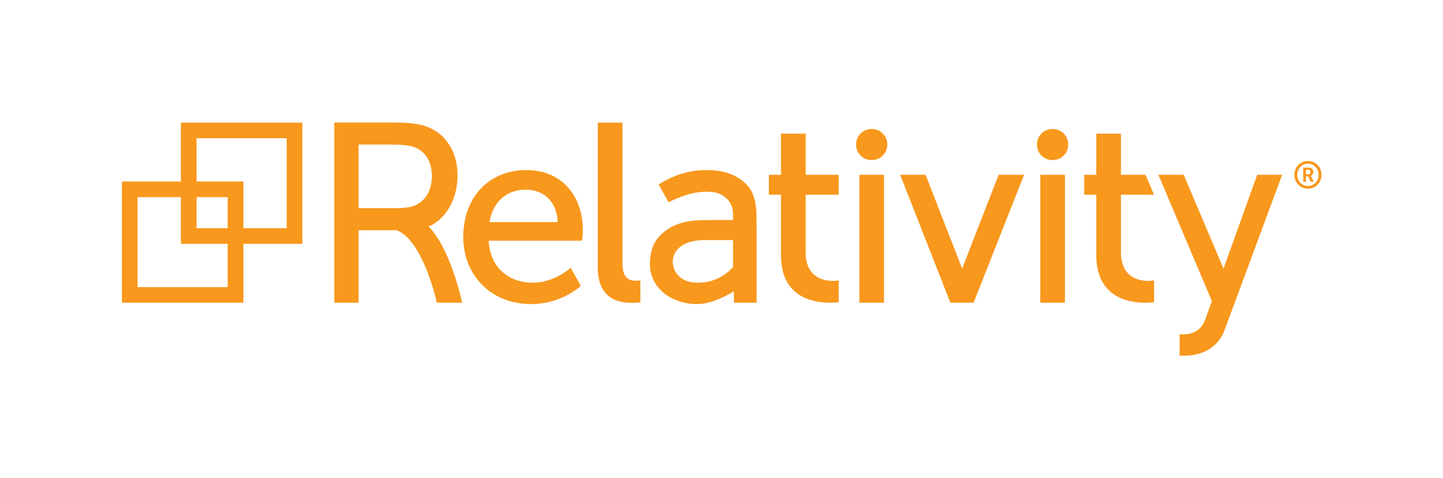
Relativity creates intuitive software that helps law firms, government agencies, financial institutions, and other major corporations quickly find the truth in data.
Founded in 2001, Relativity is headquartered in Chicago with offices worldwide in New Jersey, London, Krakow, Hong Kong, and Melbourne.
1,200+ employees
300,000+ enabled platform users
5,000+ attendees at Relativity Fest 2020, the largest conference for the e-discovery and compliance communities, and the second largest conference in legal technology
100+ developer partners and 140+ apps developed for the Relativity ecosystem
Relativity is available in 49 countries; RelativityOne is available in 9 countries and growing.

Slide 4
Unit tests effectiveness
`Behavior coverage`
How it works on real code?
Price to pay
Wrap up
AGENDA

Slide 5

Are my unit tests testing well?
Count
Line coverage
Branch coverage
???

Slide 6


Count

Slide 7
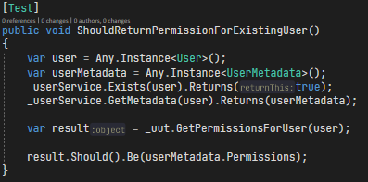
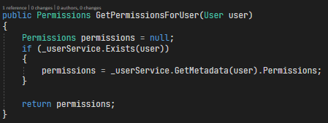
Line coverage

Slide 8
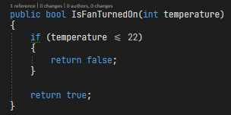
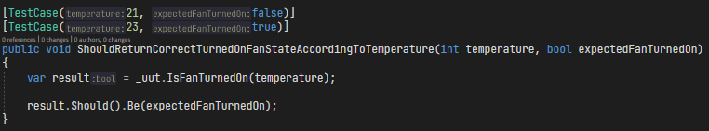
Branch coverage

Slide 9
Can we do better?
Writing code is about describing behavior in given programming language.
Testing is about ensuring that our code behaves as expected.
What if we could alter our code bahavior and verify if any test detected this change and failed?

Slide 10
Yes, we can!
Mutation testing alters our code bahavior and verify if any test detected this change and failed.

Slide 11
Mutation testing concepts
Based on two hypothesis:
experienced programmers introduce bugs by making small mistakes
small faults can cascade to bigger faults and catching small faults will also prevent big faults to happen
Glossary
Mutations operator/mutator – operation applied to original code (for example changing `<` operator to `>=`
Mutant – result of applying mutator to specified enitity (typically a class)
Mutant killed – at least one test from suite failed when executed against mutated code
Mutant survived – no test from suite failed when executed against mutated code
Mutation buckets – modified code can be valid, not valid or equivalent to other mutations
Mutation score – killed_mutants / total_numer_of_mutants

Slide 12
Mutators examples – part I
Arithmetic operators
+ | -
* | /
Equality opertors
== | !=
> | <=
Literals and constants
true | false
1 | 2
`anyString` | `otherString`

Slide 13
Mutators examples – part II
Assignement statements
+= | -=
^= | &=
Unary and update operators
-variable | +variable
variable++ | variable--
Regex mutators
Language specific mutators
LINQ `All()` | LINQ `Any()`

Slide 14
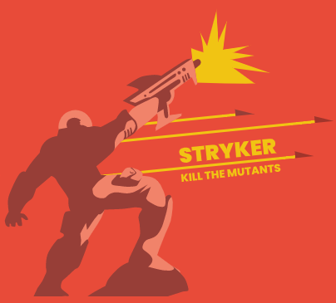
Mutation testing for .NET in action
https://stryker-mutator.io/
NetFramework and NetCore support
Simple to configure and use
Optimized for high speed execution
Huge variety of mutators supported

Slide 15

It looks fantastic doesn’t it?
Mutation testing requires huge computational power
Execution time is a problem especially for large codebases
There is a possibility to report false positives

Slide 16
So why even bother?
Mutation testing has power to be standard for assessing test suite strength
Over the time mutations testing will give you inner sense for creating meaningful tests
For codebases with low coverage, mutation testing will show you how to write tests with strong assertions
For codebases with high coverage it will point you to some weak spots of your code
It will help you to maintain high quality of your test suite

Slide 17

Internships
Students can take on paid, real-world assignments:
Write code
Work on a team of professionals
Gain tailored work experience
Social activities to grow your network
Interns are assigned a mentor to ensure getting the most out of the experience
This year all internships will be remote
Notes:
Interns and apprentices at Relativity aren’t errand-runners. From the moment you step in the door, you’ll play a critical role in our global business.
Relativity hosts immersive internship programs across the company, where college students and recent grads take on real-world assignments. You’ll write code, work on a team of professionals, and gain work experience that’s tailored to you. And yes – you’ll get paid for it, too.

Slide 18
Thank you for attending Q & A time!

Slide 19





Stay connected with us @RelativityHQ

Slide 20
Resources
https://elearningindustry.com/wp-content/uploads/2016/11/practical-learning-measurement-e1479981619388.jpeg
https://blog.providentmetals.com/wp-content/uploads/2019/01/stack-of-silver-bars.jpg
https://www.cwgmarkets.com/assets/images/gold.jpeg
https://stryker-mutator.io/
https://i.ytimg.com/vi/UkLtnp4vD8M/hqdefault.jpg

